Slide 1


Data Engineering

Slide 2
Technology choices
1.Data Storage
2.Batch Processing
3.Analytical and Data Store
4.Analytics and Reporting

Slide 3
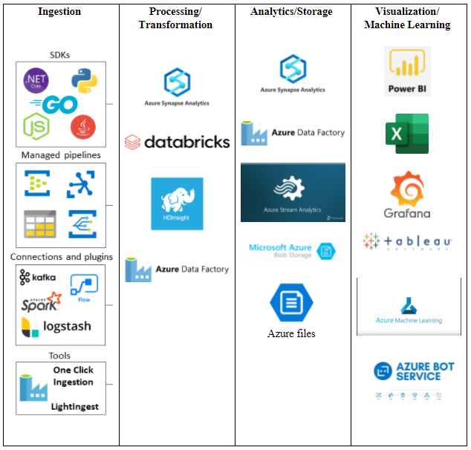
Batch processing services
Ingestion
Processing/
Transformation
Analytics/Storage
Azure files
Visualization/
Machine Learning

Slide 4
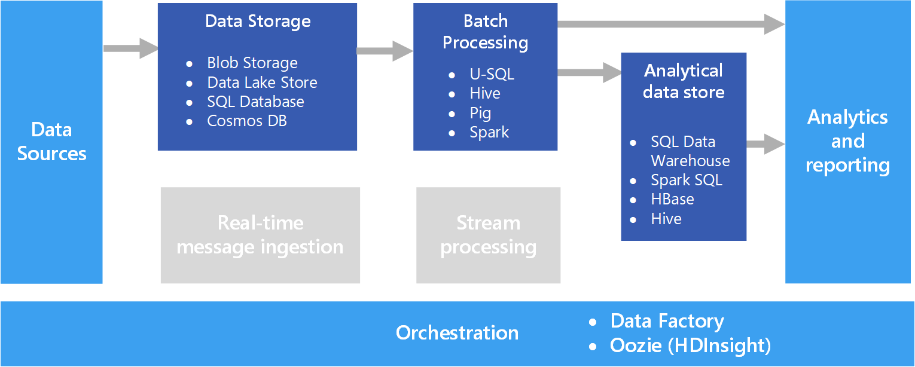
Common Architecture example

Slide 5
ETL vs ELT
Regardless of whether it's ETL or ELT, the data transformation/integration process involves the following three steps:
Extract: Extraction refers to pulling the source data from the original database or data source. With ETL, the data goes into a temporary staging area. With ELT, it goes immediately into a data lake storage system.
Transform: Transformation refers to the process of changing the structure of the information, so it integrates with the target data system and the rest of the data in that system.
Load: Loading refers to the process of depositing the information into a data storage system.

Slide 6
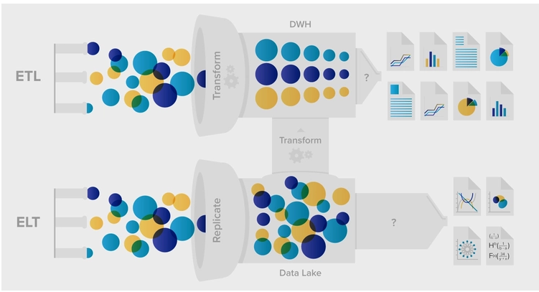

Slide 7
The five critical differences of ETL vs ELT
ETL is the Extract, Transform, and Load process for data. ELT is Extract, Load, and Transform process for data.
In ETL, data moves from the data source to staging into the data warehouse.
ELT leverages the data warehouse to do basic transformations. There is no need for data staging.
ETL can help with data privacy and compliance by cleaning sensitive and secure data even before loading into the data warehouse.
ETL can perform sophisticated data transformations and can be more cost-effective than ELT.

Slide 8
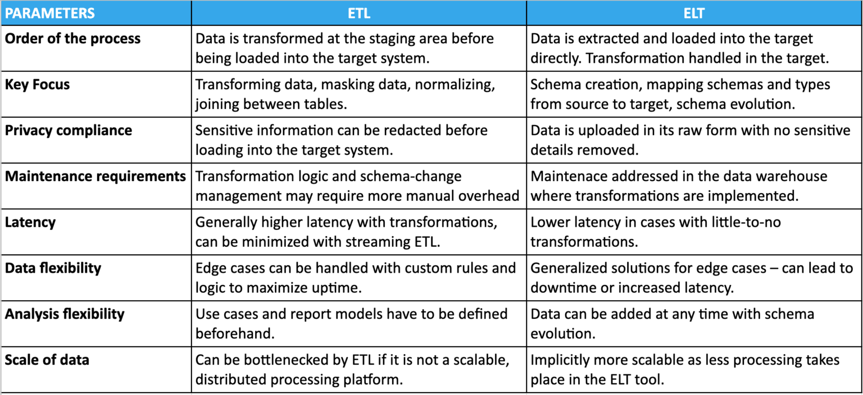

Slide 9
Is ETL part of data integration?
ETL is a type of data integration that refers to the three steps (extract, transform, load) used to blend data from multiple sources. It's often used to build a data warehouse.

Slide 10
ETL is one type of data ingestion, but it’s not the only type. ELT (extract, load, transform) refers to a separate form of data ingestion in which data is first loaded into the target location before (possibly) being transformed.

Slide 11
ELT (Extract, Load, Transform)
ELT is a more modern data ingestion strategy where data is ingested and stored in raw form in the data store before being transformed to make it ready for consumption.

Slide 12
Data ingestion
ETL
ELT
Key focus on transforming, masking, normalizing
Key focus on schema creation, mapping,evolution
Extract
Transform
Load

Slide 13
Thank You!

